Slide 1
Software Risk Management
Lecturer: Ngo Huy Bien
Software Engineering Department
Faculty of Information Technology
VNUHCM - University of Science
Ho Chi Minh City, Vietnam
nhbien@fit.hcmus.edu.vn

Slide 2

Objectives
To identify project risks
To analyze project risks
To propose and select risk responses
To create risk management plan
To monitor and track project risks

Slide 3

Contents
Risk list
Decision trees
Risk management plan

Slide 4

References
C. Ravindranath Pandian (2007). Applied Software Risk Management A Guide for Software Project Managers.
Kathy Schwalbe (2017). An Introduction to Project Management. 6th Edition. Schwalbe Publishing.
Hooman Hoodat and Hassan Rashidi (2009). Classification and Analysis of Risks in Software Engineering.
Barry W. Boehm (1991). Software Risk Management Principles and Practices.
M. T. Taghavifard et al. (2009). Decision Making Under Uncertain and Risky Situations.
RD Shachter (1986). Evaluating Influence Diagrams.

Slide 5
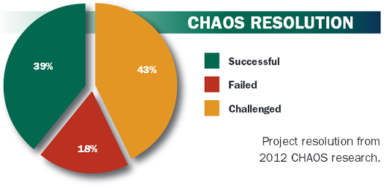

Why Do Projects Fail?
All software projects are unique undertakings.
planned scope, resources, cost and schedule
known unknowns (future events)
final project cost, performance, and schedule
Know as many as possible unknowns.

Slide 6

How to Prevent Potential Problems

Slide 7


Risk [1]
Risk is the possibility of something bad happening at some time in the future.
Risk is the probability of suffering loss while pursuing goals due to factors that are unpredictable or beyond.

Slide 8


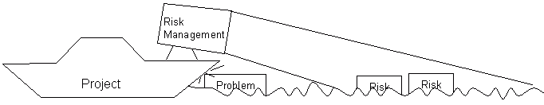
Risk vs. Problem

Slide 9
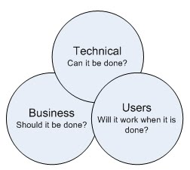
1. Identify Risks
Risk Identification produces lists of the project-specific risk items likely to compromise a project's satisfactory outcome.
Technical risks
Management risks
User acceptance risks
Maintainability risks
Financial risks
Contractual and legal risks

Slide 10
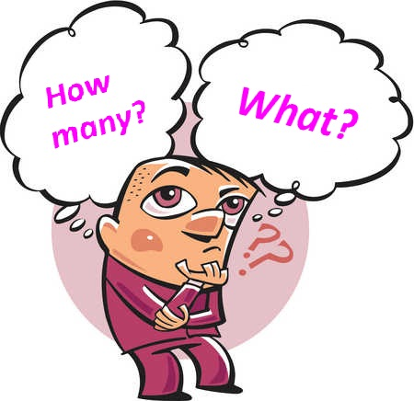

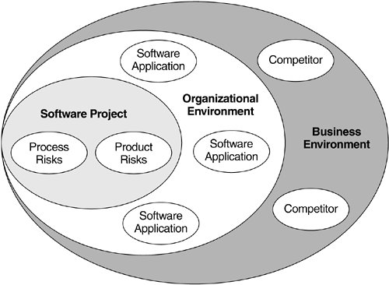

How to Indentify Risks?
Brainstorming
Risk taxonomies
Decomposition
Critical path analysis
Interviewing
Assumption analysis
Voluntary reporting
Past projects comparison

Slide 11

Software Risk Check List (I)
Unclear requirements
Too many requirement changes
Unrealistic schedules
Working on new technology
Manpower attrition
Slow performance
Working on new process
Lack of leadership

Slide 12

Software Risk Check List (II)
The mid-course correction
Padded estimates generate distrust
Self-fulfilling prophecy
Working backward from a deadline
Misunderstood predecessors
Iteration abuse
Problems are found too late
Big, useless meetings
The indispensable "hero"

Slide 13

Challenges in Previous Classes (I)
Team members leaving or losing motivation.
Unclear requirements: Real world problems, domain knowledge.
Availability and cost of reliable AI coding agents.
Earlier releases from competitors.

Slide 14

Challenges in Previous Classes (II)
Not enough time
Working on new technologies
Lack of leadership
No status reporting
Unclear requirements: Real world problems, domain knowledge.

Slide 15
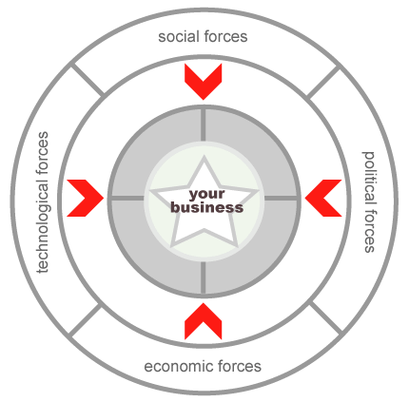
PEST Analysis
PEST analysis is a strategic planning method used to review a strategy or position, direction of a company, a marketing proposition, or idea in a project.
Brainstorm the relevant factors that apply to you
Identify the information that applies to these factors
Draw conclusions from this information

Slide 16
SWOT Analysis
SWOT analysis is a strategic planning method used to evaluate the Strengths, Weaknesses, Opportunities, and Threats involved in a project.
Objective
Strengths
Weaknesses
Opportunities
Threats
Competitors, changes, team work
Learning, skill and knowledge improvement
Experiences, skills, time
Skills, prices, motivation, resources

Slide 17
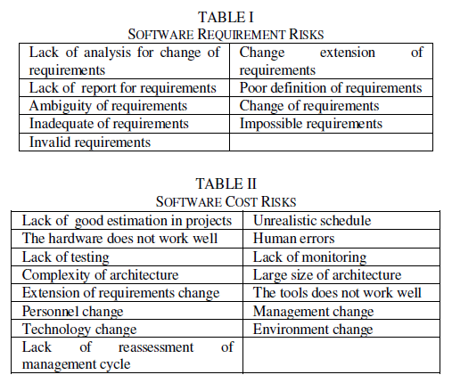
Risk Identification Product

Slide 18


Slide 19
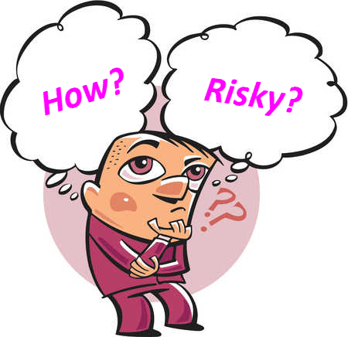
2. Analyze Risks
Risk analysis is the scientific measurement of the degree of danger or hazard involved in any operation or activity.
“How risky are my risks?”

Slide 20


Risk Characterization
Probability | Description
0% – 20% | Remote
20% – 40% | Unlikely
40% – 70% | Likely
70% – 90% | Highly likely
90% – 100% | Nearly certain
Time of Occurrence
In next month
One to two months from now
Three or more months from now
Impact (Slips to schedule and budget) | Description
< 10% of total budget | Minimal or no impact
< 15% of total budget | Small, acceptable
< 50% of total budget | Moderate system damage
< 60% of total budget | Significant impact to project
>= 60% of total budget | Failure of project operations

Slide 21
Example
Strategy
Experience
Not enough time: P = 80%, C = $4000, 2 months.
Working on new technology: P = 40%, C = $2000, 1 week.
Lack of leadership: P = 95%, C = $100, 1 month.

Slide 22
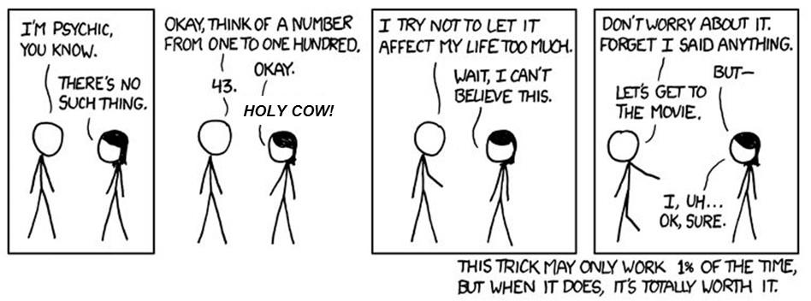

Uncertainty [2]

Slide 23

Delphi Method
Delphi method is a method for structuring a group communication process so that the process is effective in allowing a group of individuals, as a whole, to deal with a complex problem.
Develop initial questionnaire and distribute it to the panel.
Panelists independently generate their ideas in answer to the questionnaire and return it.
The moderator summarizes the responses to the first questionnaire and develops a feedback report along with the second set of questionnaires for the panelists.
Having received the feedback report, panelists independently evaluate earlier responses and independently vote on the second questionnaire.
The moderator develops a final summary and feedback report to the group and decision makers.

Slide 24
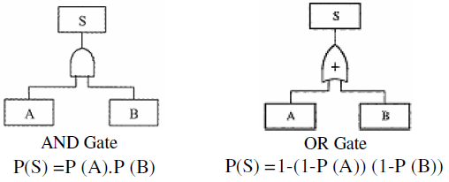
Risk Tree Analysis [3]
Risk tree is a graphical model of various combinations of risks that result in the occurrence of the predefined undesired event.
To analyze using risk tree, it is necessary to
specify the undesired state of the system. This state may be the failure of the system or of a subsystem.
Then a list is made of all the possible ways in which these events can occur.
Each of the possible ways is then examined independently to find out how it can occur.

Slide 25
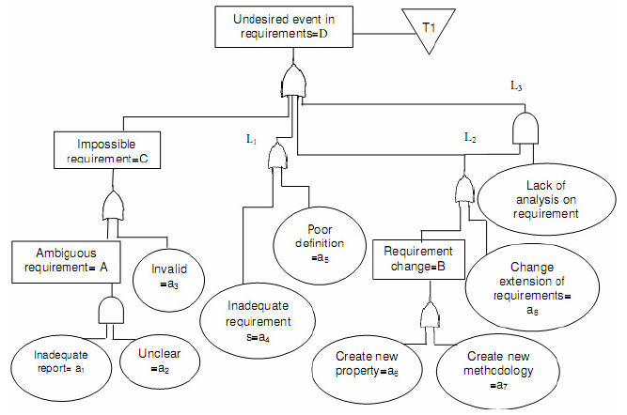
Risk Tree Example
Rectangle:
Top or intermediate event
Transfer
The output is generated if at least one of the inputs exists
Circle:
Elementary basic event

Slide 26
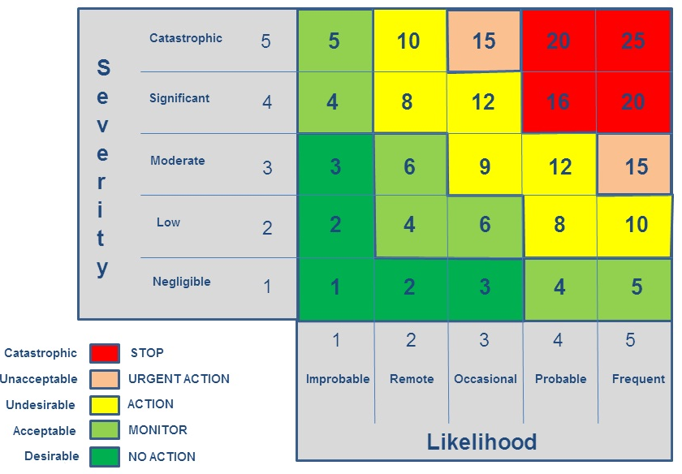
Risk Exposure (Priority)
Risk exposure is defined as
Risk Exposure (Priority) = Probability * Impact.
It is simply the average impact.
Risk Matrix

Slide 27

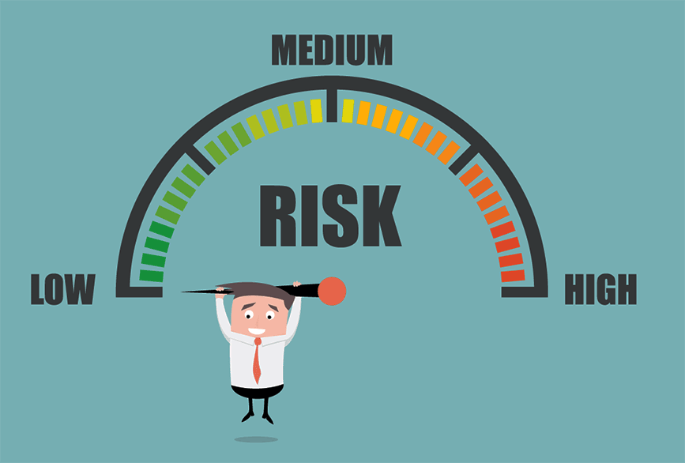
3. Prioritize Risks
Strategy
Experience
Not enough time: P = 80%, C = $4000, 2 months.
Working on new technology: P = 40%, C = $2000, 1 week.
Lack of leadership: P = 95%, C = $100, 1 month.
Priority = P * C and consider time of occurrence.

Slide 28
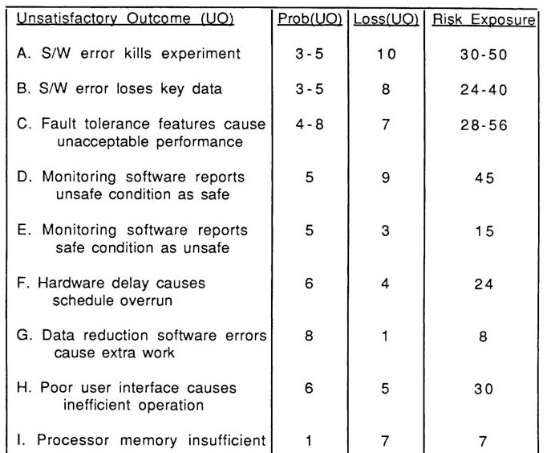
Risk Analysis Product [4]

Slide 30




Risk Response
Acceptance: To acknowledge the risk’s existence, but to take no preemptive action to resolve it, except for the possible development of contingency plans should the risk event come to pass.
Avoidance: To eliminate the conditions that allow the risk to be present at all, most frequently by dropping the project or the task.
Deflection: To transfer the risk (in whole or part) to another organization, individual, or entity.
Mitigation: To minimize the probability of a risk’s occurrence or the impact of the risk should it occur.

Slide 31
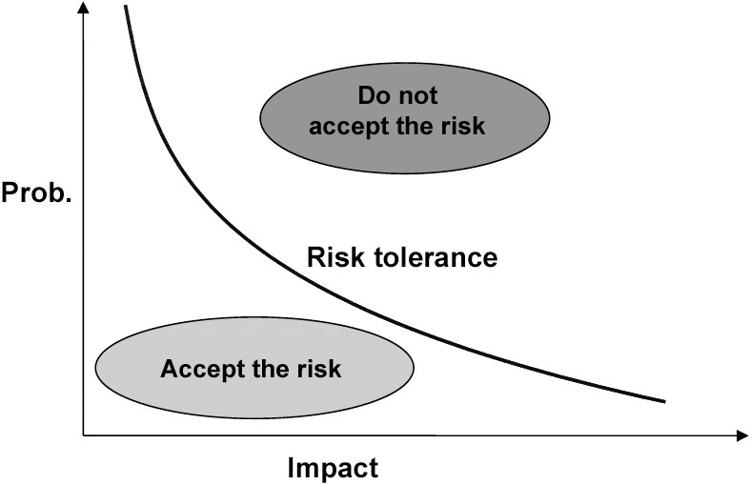
Risk Tolerance
Risk tolerance is the willingness of some person or some organization to accept or avoid risk.

Slide 32
Example of Risk Mitigation (I)
Inexperience with project process/technology
Make estimates with a buffer for initial learning time
Maintain buffers of extra resources
Define a project-specific training program
Conduct cross-training sections
Unclear requirements and/or acceptance criteria
Use experience and logic to make some assumptions and keep the client informed; obtain sign-off
Develop a prototype and have the requirements reviewed by the client.

Slide 33
Example of Risk Mitigation (II)
Too many requirement changes
Obtain sign-off for the initial requirements specification from the customer.
Convince the customer that changes in requirements will affect the schedule
If the requirements are changing rapidly we should RE-ESTIMATE the final delivery date and NOTIFY the manger about the new schedule AS SOON AS we receive a change request.
We should NOT let the manager know the effect on the last day.
Define a procedure to handle requirement changes
Negotiate payment on actual effort
Unrealistic schedules
Negotiate for a better schedule.
Identify parallel tasks.
Have resources ready early
Identify areas that can be automated, COTS components
If the critical path is not within the schedule, negotiate with the client
Negotiate payment on actual effort.

Slide 34
Example of Risk Mitigation (III)
Team spirit and attitude
Ensure that multiple resources are assigned on key project areas.
Have team-building sessions.
Rotate jobs among team members
Keep extra resources in the project as backup.
Maintain proper documentation of each individual's work.
Follow the configuration management process and guidelines strictly.
Not meeting performance requirements
Define the performance criteria clearly and have them reviewed by the client.
Define standards to be followed to meet the performance criteria
Prepare the design to meet performance criteria and review it.
Simulate or prototype performance of critical transactions.
Test with a representative volume of data where possible.
Conduct stress tests where possible.

Slide 35
Example of Risk Mitigation (IV) [4]
1 | Personnel shortfalls | Staffing with top talent; job matching (matching the right people with the right job); teambuilding; morale building; cross-training ; prescheduling key people
2 | Unrealistic schedules and budgets | Detailed multisource costs & schedule estimation; design to cost; incremental development; software reuse; requirements scrubbing
3 | Developing the wrong software functions | Organization analysis; mission analysis; ops-concept formulation ; user survey; prototyping; early users' manuals
4 | Developing the wrong user interfacing | Prototyping; scenarios; task analysis
5 | Gold plating | Requirements scrubbing; prototyping; cost-benefit analysis; design to cost
6 | Continuing stream of requirements changes | High change threshold; information hiding; incremental development (defer changes to later increments)
7 | Shortfalls in externally furnished components | Benchmarking; inspections; reference checking; compatibility analysis
8 | Shortfalls in externally performed tasks | Reference checking; pre-award audits; award-fee contacts; competitive design or prototyping; teambuilding
9 | Real-time performance shortfalls | Simulation; benchmarking; modeling; prototyping; instrumentation; tuning
10 | Straining computer science capabilities | Technical analysis; cost-benefit analysis; prototyping; reference checking.

Slide 36

Risk Mitigation: Buying Information
Scenarios
Modeling
Prototyping
Task analysis
Software reuse
Cost-Benefit analysis
Some risk is necessary for potential reward.
You can avoid risks by investing your money in a bank savings account, but you won't get rich that way.

Slide 37
4. List Risk Reponses
Not enough time
?
?
Working on new technology
?
Lack of leadership
?
Unclear requirements
?
?

Slide 39

Response Analysis [4]
Unclear requirements (P = 70%, Loss = $3000)
Use experience and logic to make some assumptions and keep the client informed (P = 40%, Cost = $400).
Develop a prototype and have the requirements reviewed by the client (P = 5%, Cost = $1000).

Slide 40
Decision Tree [5]
A decision tree is a chronological representation of the decision process.
It utilizes a network of two types of nodes:
decision (choice) nodes (represented by square shapes), and
states of nature (chance) nodes (represented by circles).
Unclear requirements
Mitigation
40%
60%
Prototype
5%
95%
Acceptance
Assumptions
70%
30%
$3000
$0
$3400
$400
$4000
$1000
$3000 + $400
$3000 + $1000

Slide 41
How to Use a Decision Tree?
Draw the decision tree using squares to represent decisions and circles to represent uncertainty,
Evaluate the decision tree to make sure all possible outcomes are included,
Calculate the tree values working from the right side back to the left,
Calculate the values of uncertain outcome nodes by multiplying the value of the outcomes by their probability (i.e., expected values or average impact).
Unclear requirements
Mitigation
40%
60%
Prototype
5%
95%
Acceptance
Assumptions
70%
30%
$3000
$0
$3400
$400
$4000
$1000
$2100
$1600
$1150

Slide 42
Risk Reduction Leverage [4]
Risk reduction leverage provides a cost benefit analysis of treatment options. (1$ reduces ? average impact)
Risk Reduction Leverage =
(RE_{before} – RE_{after}) / Risk Reduction Cost
Unclear requirements
Mitigation
40%
60%
Prototype
5%
95%
Acceptance
Assumptions
70%
30%
$3000
$0
$4100
$400
$4000
$1000
$2100
RRL:1.25
$1600
Cost = $400
$1150
Cost = $1000
RRL:0.95

Slide 43
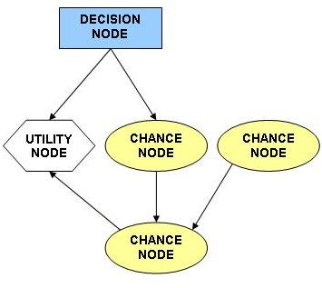
Influence Diagram [6]
An influence diagram is a graphical structure for modeling uncertain variables and decisions and explicitly revealing probabilistic dependence and the flow of information.
Influence diagram consists of nodes or variables connected by directed arrows. There are three kinds of nodes:
(1) decision nodes representing alternative actions that can be taken by decision makers;
(2) chance nodes representing events or system variables that are outcomes of the decision or other chance variables;
(3) value or utility nodes, variables that summarize the final outcome of a decision.

Slide 45

6. Create Risk Management Plan
Risk management planning produces plans for addressing each risk item (e.g., via risk avoidance, risk transfer, risk reduction, or buying information), including the coordination of the individual risk-item plans with each other and with the overall project plan.
The plan is organized around a standard format for software plans, oriented around answering the standard questions of "why, what, when, who, where, how, and how much.“
This plan organization allows the plans to be concise (e.g., fitting on one page), action-oriented, easy to understand, and easy to monitor.
[IEEE Std 1540-2001]

Slide 46
Risk Management Plan Example (I)
1 Risk
Risk Management Plan: Fault Tolerance Prototyping
1. Objectives (The “Why”)
Determine, reduce level of risk of the software fault tolerance features causing unacceptable performance
Create a description of and a development plan for a set of low-risk fault tolerance features
2. Deliverables and Milestones (The “What” and “When”)
- By week 3
1. Evaluation of fault tolerance option
2. Assessment of reusable components
3. Draft workload characterization
4. Evaluation plan for prototype exercise
5. Description of prototype
- By week 7
6. Operational prototype with key fault tolerance features
7. Workload simulation
8. Instrumentation and data reduction capabilities
9. Draft Description, plan for fault tolerance features
-By week 10
10. Evaluation and iteration of prototype
11. Revised description, plan for fault tolerance features

Slide 47
Risk Management Plan Example (II)
3. Responsibilities (The “Who” and “Where”)
- System Engineer: G. Smith
Tasks 1, 3, 4, 9, 11, support of tasks 5, 10
- Lead Programmer: C. Lee
Tasks 5, 6, 7, 10 support of tasks 1, 3
- Programmer: J. Wilson
Tasks 2, 8, support of tasks 5, 6, 7, 10
4. Approach (The “How”)
Design-to-Schedule prototyping effort
Driven by hypotheses about fault tolerance-performance effects
Use real-time OS, add prototype fault tolerance features
Evaluate performance with respect to representative workload
Refine Prototype based on results observed
5. Resources (The “How Much”)
$60K - Full-time system engineer, lead programmer, programmer (10weeks)*(3 staff)*($2K/staff-week)
$0K - 3 Dedicated workstations (from project pool)$0K - 2 Target processors (from project pool)
$0K - 1 Test co-processor (from project pool)
$10K – Contingencies
$70K - Total

Slide 48
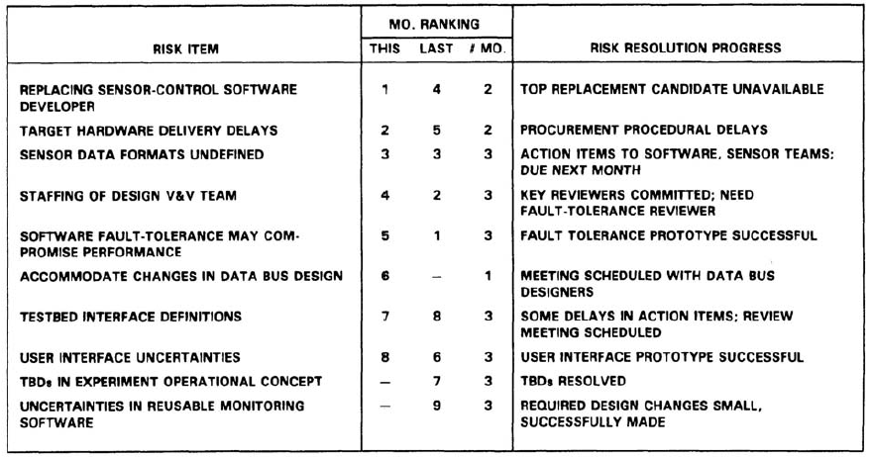
7. Monitor Risks
Risk monitoring involves tracking the project's progress towards resolving its risk items and taking corrective action where appropriate.

Slide 49

Risk Management
Risk management is a systematic approach to reducing the harm due to risks, making the project less vulnerable and the product more robust.
Risk Management
Risk Assessment
Risk Identification
Risk Analysis
Risk Control
Risk Management Planning
Risk Prioritization
Risk Resolution (Taking Action)
Risk Monitoring

Slide 50

Why Risk Management?
Improve governance and controls
Reduce losses and the impact of risks to objectives
Comply with legal and regulatory requirements
"If you don't actively attack the risks, they will actively attack you." --Tom Gilb

Slide 51

Thank You & See You Again

